Slide 1
CSE440 • ARTIFICIAL INTELLIGENCE
AUTONOMOUS INDOOR NAVIGATION ROBOT
PROJECT GROUP 6
MD ASRAFUL HOSSAIN 2232845642 MD. SADMAN BIN MURTOZA 2232901642 FAHIMA SHAMEEM 2131420642 SANJIDA JAMAN 2212231042
Using A* Search for Path Planning with Dynamic Obstacle Replanning
SOFTWARE-ONLY SIMULATION
Python • Tkinter • Occupancy Grid • A* • Virtual Robot
SECTION 2 • FACULTY: MSRB NORTH SOUTH UNIVERSITY
GROUP 6 • MD ASRAFUL HOSSAIN • MD. SADMAN BIN MURTOZA • FAHIMA SHAMEEM • SANJIDA JAMAN
01

Slide 2
02
The AI Problem
Indoor navigation as a goal-based intelligent-agent problem
INTELLIGENT-AGENT LOOP
THE TASK
Move from a chosen START cell to a DESTINATION while avoiding blocked cells.
1
REPRESENT
2
PLAN
Model the indoor world
Use A* to select a safe route
The agent must choose actions, maintain a valid plan, and react when the environment changes.
3
ACT
4
ADAPT
Move one cell at a time
Replan when the route becomes blocked
STATE
occupancy grid + robot position + start/goal
GOAL
reach destination safely with minimum grid moves
PROJECT OBJECTIVE
Build a complete, observable simulation of this loop—not a physical robot.
GROUP 6 • MD ASRAFUL HOSSAIN • MD. SADMAN BIN MURTOZA • FAHIMA SHAMEEM • SANJIDA JAMAN
02

Slide 3
03
Environment Representation
The floor plan is converted into a graph-search problem
OCCUPANCY GRID
WHAT THE MAP MODULE HANDLES
• Creates/resizes the grid and stores free vs blocked cells.
S
• Lets the user choose valid start and destination cells.
• Prevents obstacles from invalidating the selected endpoints.
• Supports validated JSON save/load of the map.
WHY THIS REPRESENTATION WORKS
G
• It turns navigation into graph search with predictable unit-cost moves.
0 = FREE
1 = OBSTACLE
• Four-connected movement makes Manhattan distance a natural heuristic.
Each cell becomes a state in the search space.
• The same grid is shared by the planner, robot, GUI, and tests.
Movement model
UP • DOWN • LEFT • RIGHT
GROUP 6 • MD ASRAFUL HOSSAIN • MD. SADMAN BIN MURTOZA • FAHIMA SHAMEEM • SANJIDA JAMAN
03

Slide 4
04
Why A*? — Informed Search
A* is goal-directed: it combines what the agent has already spent with what it estimates remains
A* EVALUATION FUNCTION
WHY MANHATTAN?
f(n) = g(n) + h(n)
✓ The robot moves only in four cardinal directions.
✓ Every legal move has unit cost.
g(n)
actual movement cost from START to n
✓ Manhattan distance never overestimates the true remaining cost.
h(n)
estimated remaining distance to GOAL
✓ Therefore the heuristic is admissible for this grid.
f(n)
estimated total path cost through n
✓ With a consistent heuristic, A* returns a shortest path whenever one exists.
HEURISTIC USED
Manhattan distance = |r − r_goal| + |c − c_goal|
PRIORITY QUEUE
heapq always expands the currently lowest-f candidate.
GROUP 6 • MD ASRAFUL HOSSAIN • MD. SADMAN BIN MURTOZA • FAHIMA SHAMEEM • SANJIDA JAMAN
04

Slide 5
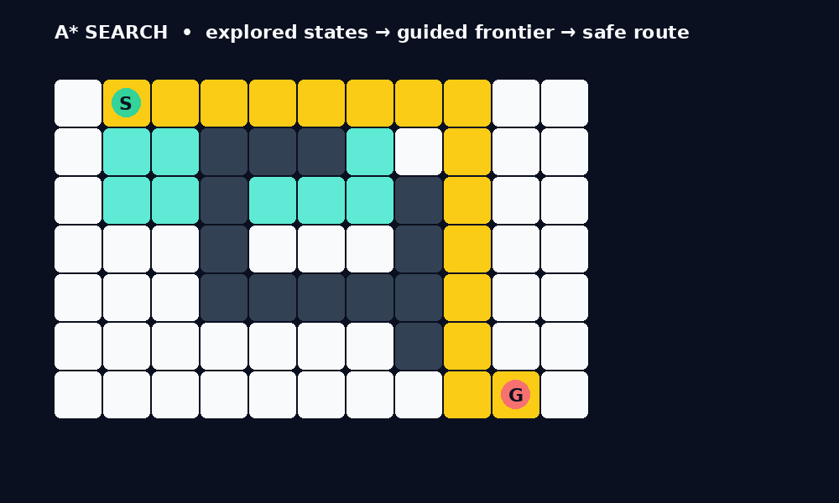
05
A* Path-Planning Process
What actually happens when the user clicks “Find A Path”
01
VALIDATE
02
EXPAND
03
EVALUATE
04
UPDATE
05
RECONSTRUCT
grid • start • goal
lowest-f node
4-connected neighbors
g / f / parent
goal → start path
WHAT THE VISUALIZATION SHOWS
• Explored cells show where the frontier search has actually expanded.
• The highlighted route is the final shortest safe path.
• The visualization is generated from the planner’s returned path/explored set—not drawn manually.
KEY IDEA
A* searches intelligently toward the goal instead of blindly scanning the whole grid.
GROUP 6 • MD ASRAFUL HOSSAIN • MD. SADMAN BIN MURTOZA • FAHIMA SHAMEEM • SANJIDA JAMAN
05

Slide 6
06
System Architecture & Team Integration
Four single-responsibility modules + one shared integration layer
MEMBER 1
ASRAFUL
MEMBER 2
SADMAN
map_model.py
Occupancy grid • obstacles • start/goal • JSON save/load
astar.py
A* search • Manhattan heuristic • validation • replanning entry point
MEMBER 3
FAHIMA
MEMBER 4
SANJIDA
virtual_robot.py
Robot state • movement • pause/resume • blocked-cell detection
gui_graphics.py
Tkinter GUI • controls • visualization • dashboard • tests
main.py • SHARED GROUP INTEGRATION
Instantiates map + planner + robot, passes them to the GUI, and starts the complete application.
Important: main.py is a GROUP-LEVEL integration file, not Sadman’s individual contribution.
GROUP 6 • MD ASRAFUL HOSSAIN • MD. SADMAN BIN MURTOZA • FAHIMA SHAMEEM • SANJIDA JAMAN
06

Slide 7
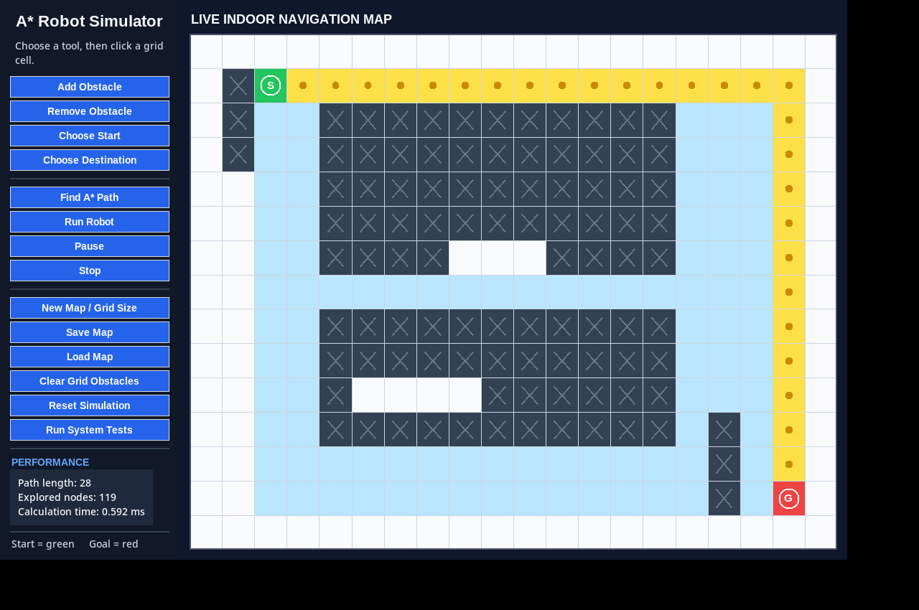
07
Virtual Robot — From Plan to Motion
Fahima’s module executes the plan while keeping robot state consistent
VIRTUAL ROBOT STATE
CURRENT POSITION
where the robot is now
TRAVELLED CELLS
the path already executed
REMAINING PATH
the cells still planned
RUNNING / PAUSED / STOPPED
explicit motion state
FINISHED
goal reached successfully
CONTROL BEHAVIOUR
Pause • Resume • Stop • Reset
GROUP 6 • MD ASRAFUL HOSSAIN • MD. SADMAN BIN MURTOZA • FAHIMA SHAMEEM • SANJIDA JAMAN
07

Slide 8
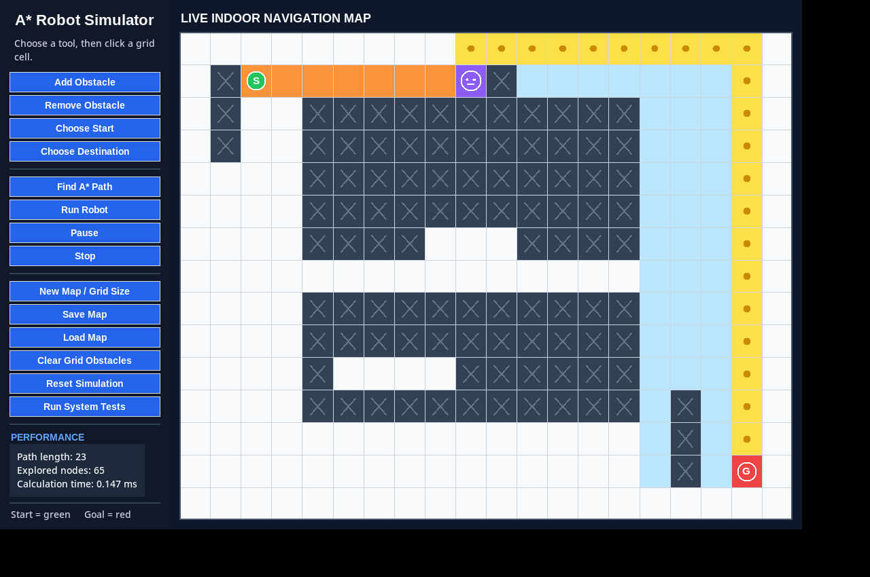
08
Dynamic Obstacle Replanning
The project’s strongest AI behaviour: the agent changes its plan when the world changes
1
FOLLOW
2
CHECK
3
BLOCKED?
4
REPLAN
5
CONTINUE
Execute current route
Inspect next cell before moving
Stop at last safe position
Run A* from current position
Accept new safe route
BEFORE
AFTER BLOCKING THE REMAINING ROUTE
GROUP 6 • MD ASRAFUL HOSSAIN • MD. SADMAN BIN MURTOZA • FAHIMA SHAMEEM • SANJIDA JAMAN
08

Slide 9
09
GUI — Visualization, Controls & Evidence
Sanjida’s interface makes the agent’s internal decisions observable
WHAT THE USER CAN SEE
WORLD
free cells, obstacles, start & destination
SEARCH
explored cells + remaining A* route
ROBOT
current position + travelled trail
CONTROLS
start / destination / obstacle / run / pause / reset
METRICS
path length • explored nodes • calculation time
Built-in testing
The GUI can run the integrated system-test suite and report pass/fail status.
GROUP 6 • MD ASRAFUL HOSSAIN • MD. SADMAN BIN MURTOZA • FAHIMA SHAMEEM • SANJIDA JAMAN
09

Slide 10
10
Testing & Measured Performance
Correctness, failure handling, replanning, integration, and representative runtime were verified
FUNCTIONAL TEST COVERAGE
REPRESENTATIVE A* RUNTIME • 200 RUNS / GRID
✓
Reachable path
valid route returned
0.129
0.320
0.762
1.268
ms
ms
ms
ms
✓
Unreachable goal
safe failure reported
10 × 10
15 × 20
20 × 30
30 × 40
✓
Narrow passage
constrained route found
83
204
458
✓
Obstacle safety
robot stops before blocked cell
10 × 10 explored
15 × 20 explored
20 × 30 explored
✓
Integration
map → A* → robot works end-to-end
ALL CORE INTEGRATION TESTS PASSED
Timing note: representative software measurements, not hardware-independent benchmarks.
GROUP 6 • MD ASRAFUL HOSSAIN • MD. SADMAN BIN MURTOZA • FAHIMA SHAMEEM • SANJIDA JAMAN
10

Slide 11
11
Current Scope, Limitations & Future Work
The simulator demonstrates the planning problem clearly while keeping its boundaries explicit
CURRENT SCOPE
LIMITATIONS
NEXT STEPS
• Software-only simulation; no physical robot or sensors.
• No sensor-based obstacle discovery.
• 8-connected motion + octile heuristic.
• 2D binary occupancy grid.
• No localization uncertainty or physical stopping distance.
• Limited sensor range and discovered obstacles.
• Four-direction, uniform-cost movement.
• No diagonal movement or weighted terrain costs.
• Weighted cells for different terrain costs.
• Dynamic obstacles are user-triggered grid edits.
• Repeated full A* searches may become inefficient on much larger changing maps.
• Import real floor plans instead of a fixed grid.
• Tkinter provides interactive visualization and controls.
We deliberately present these as future work—not capabilities the current system does not have.
GROUP 6 • MD ASRAFUL HOSSAIN • MD. SADMAN BIN MURTOZA • FAHIMA SHAMEEM • SANJIDA JAMAN
11

Slide 12
12
Final Takeaway
A complete CSE440 intelligent-agent workflow, implemented and tested as one integrated system
REPRESENT
PLAN
ACT
OBSERVE
ADAPT
Occupancy grid Asraful
A* + Manhattan Sadman
Virtual robot Fahima
GUI + tests Sanjida
Dynamic replanning Group
WHAT WE ACTUALLY DEMONSTRATE
Shortest safe grid path • visible search process • safe cell-by-cell execution • automatic replanning • measured performance • integrated testing
GROUP 6 • CSE440 • SECTION 2 • FACULTY: MSRB
GROUP 6 • MD ASRAFUL HOSSAIN • MD. SADMAN BIN MURTOZA • FAHIMA SHAMEEM • SANJIDA JAMAN
12

Slide 13
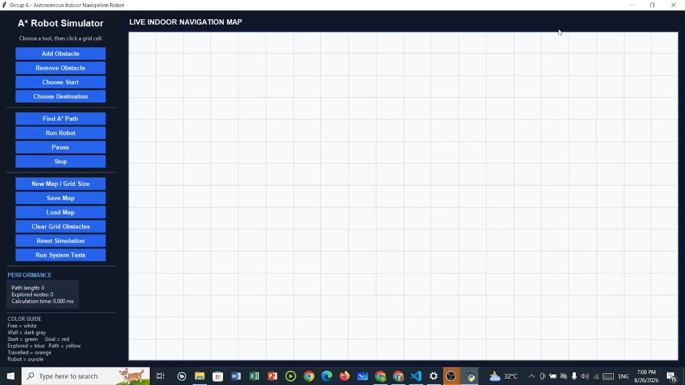
13
Live Demo — Autonomous Indoor Navigation
Project demonstration: A* path planning with dynamic obstacle replanning
DEMO HIGHLIGHTS
• A* path planning on an occupancy grid
• Virtual robot follows the computed route
• Obstacle insertion during execution
• Automatic replanning to a safe alternative path
• Live GUI visualization and performance feedback
PROJECT DEMONSTRATION • A* PATH PLANNING • DYNAMIC REPLANNING
GROUP 6 • MD ASRAFUL HOSSAIN • MD. SADMAN BIN MURTOZA • FAHIMA SHAMEEM • SANJIDA JAMAN
13

